Slide 1
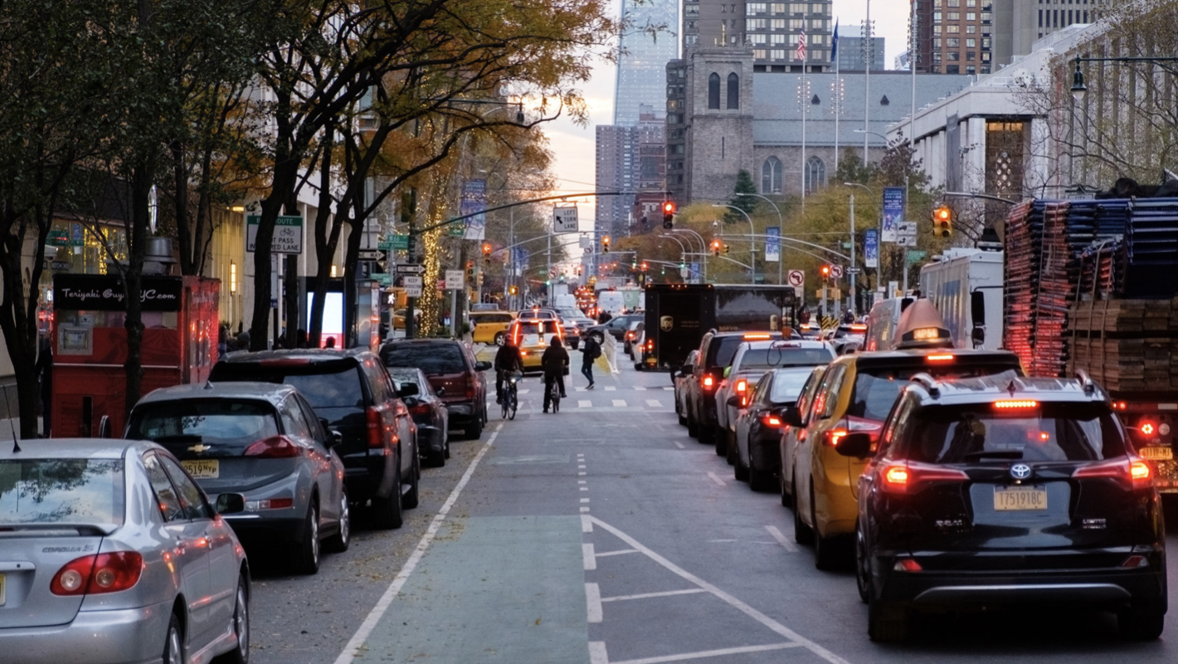
Park Smart NYC Parking App

Slide 2

Business Need
Average Parking Ticket in New York City is $85

Slide 3

Goal
Help locate an ideal free parking spot in NYC with minimal risk of getting a parking violation ticket

Slide 4
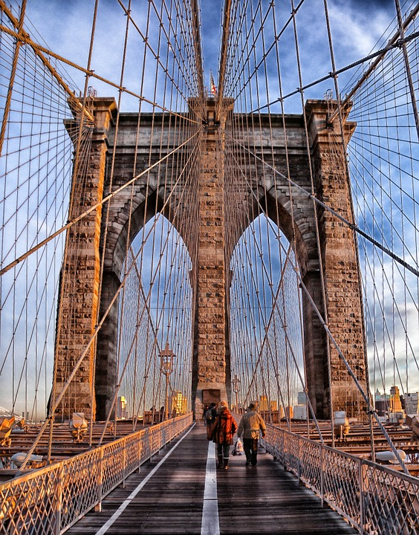
Methodology
Parking Violations Data: NYC Open Data
Cleaning/EDA: Google Sheets
Data Visualization: Tableau

Slide 5
Insights
Top reason for Violation
Obstructing Driveway
Time of most Violations
Wed 9am – 11am
Top county for Violations
Brooklyn

Slide 6
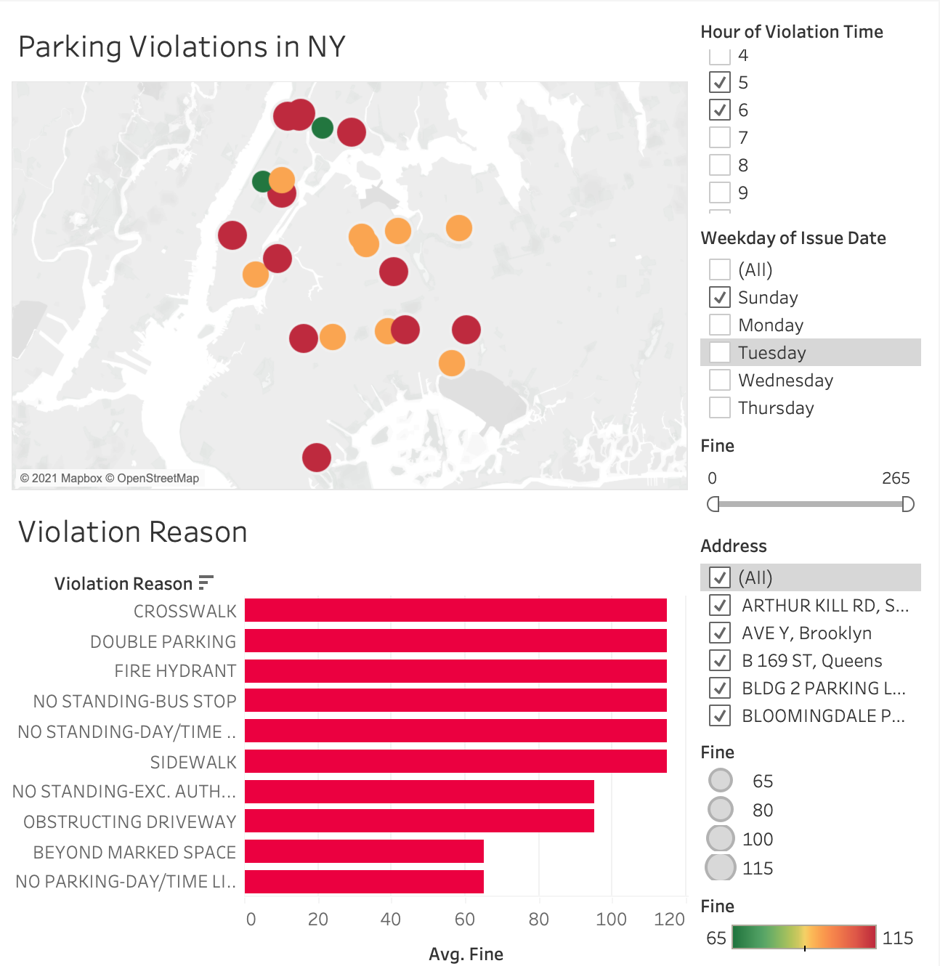
Parking Violation Map
Top Areas for Parking Violations
Adams St., Brooklyn
Broadway, Manhattan
Hillside Ave, Queens
Croton Pl, Staten Island
Sherman Ave, Bronx

Slide 7
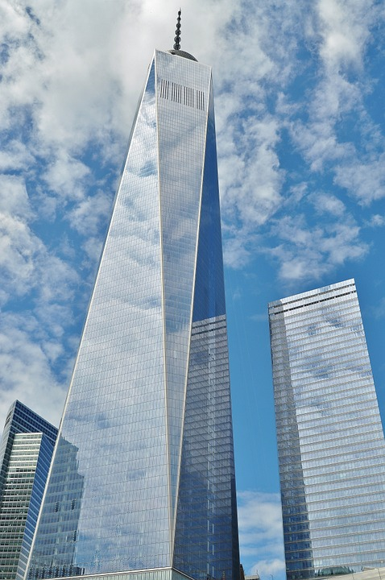

Next steps
Include Additional information such as Vehicle model and license plate information from the dataset.

Slide 8
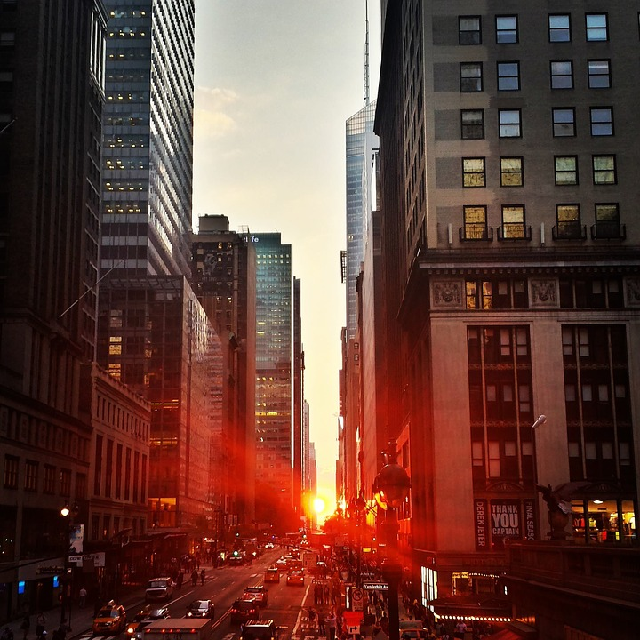
Solutions
Build a clustering model with the hypothesis that certain clusters will indicate higher probability of parking violations

Slide 9


